Slide 1
Philippians 4
Love, Peace and Contentment

Slide 2
Therefore, my brothers,^{[a]} whom I love and long for, my joy and crown, stand firm thus in the Lord, my beloved.
Exhortation, Encouragement, and Prayer
² I entreat Euodia and I entreat Syntyche to agree in the Lord. ³ Yes, I ask you also, true companion,^{[b]} help these women, who have laboured side by side with me in the gospel together with Clement and the rest of my fellow workers, whose names are in the book of life.

Slide 3
4 Rejoice in the Lord always; again I will say, Rejoice. 5 Let your reasonableness be known to everyone. The Lord is at hand; 6 do not be anxious about anything, but in everything by prayer and supplication with thanksgiving let your requests be made known to God. 7 And the peace of God, which surpasses all understanding, will guard your hearts and your minds in Christ Jesus.

Slide 4
8 Finally, brothers, whatever is true, whatever is honourable, whatever is just, whatever is pure, whatever is lovely, whatever is commendable, if there is any excellence, if there is anything worthy of praise, think about these things. 9 What you have learned and received and heard and seen in me—practise these things, and the God of peace will be with you.

Slide 5
God's Provision
10 I rejoiced in the Lord greatly that now at length you have revived your concern for me. You were indeed concerned for me, but you had no opportunity. 11 Not that I am speaking of being in need, for I have learned in whatever situation I am to be content. 12 I know how to be brought low, and I know how to abound. In any and every circumstance, I have learned the secret of facing plenty and hunger, abundance and need. 13 I can do all things through him who strengthens me.

Slide 6
14 Yet it was kind of you to share[c] my trouble. 15 And you Philippians yourselves know that in the beginning of the gospel, when I left Macedonia, no church entered into partnership with me in giving and receiving, except you only. 16 Even in Thessalonica you sent me help for my needs once and again. 17 Not that I seek the gift, but I seek the fruit that increases to your credit.[d] 18 I have received full payment, and more. I am well supplied, having received from Epaphroditus the gifts you sent, a fragrant offering, a sacrifice acceptable and pleasing to God. 19 And my God will supply every need of yours according to his riches in glory in Christ Jesus. 20 To our God and Father be glory for ever and ever. Amen.

Slide 7
Final Greetings
21 Greet every saint in Christ Jesus. The brothers who are with me greet you. 22 All the saints greet you, especially those of Caesar's household.
23 The grace of the Lord Jesus Christ be with your spirit.

Slide 8
Love, Peace and Contentment
Paul loved the Philippians
The Peace of God
Contentment in Life

Slide 9
Paul loved the Philippians

Slide 10
Matthew 7 v 24 -27
²⁴ “Everyone then who hears these words of mine and does them will be like a wise man who built his house on the rock. ²⁵ And the rain fell, and the floods came, and the winds blew and beat on that house, but it did not fall, because it had been founded on the rock. ²⁶ And everyone who hears these words of mine and does not do them will be like a foolish man who built his house on the sand. ²⁷ And the rain fell, and the floods came, and the winds blew and beat against that house, and it fell, and great was the fall of it.”

Slide 11
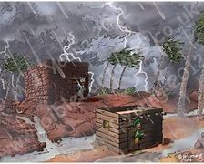

Slide 12
“This is my beloved Son, with whom I am well pleased; listen to him.”
But you, beloved, building yourselves up in your most holy faith and praying in the Holy Spirit,
Beloved, if our heart does not condemn us, we have confidence before God;
Know this, my beloved brothers: let every person be quick to hear, slow to speak, slow to anger;
Beloved, never avenge yourselves, but leave it to the wrath of God, for it is written, “Vengeance is mine, I will repay, says the Lord.”
Beloved, do not be surprised at the fiery trial when it comes upon you to test you, as though something strange were happening to you
Though we speak in this way, yet in your case, beloved, we feel sure of better things—things that belong to salvation.

Slide 13
The Peace of God

Slide 14
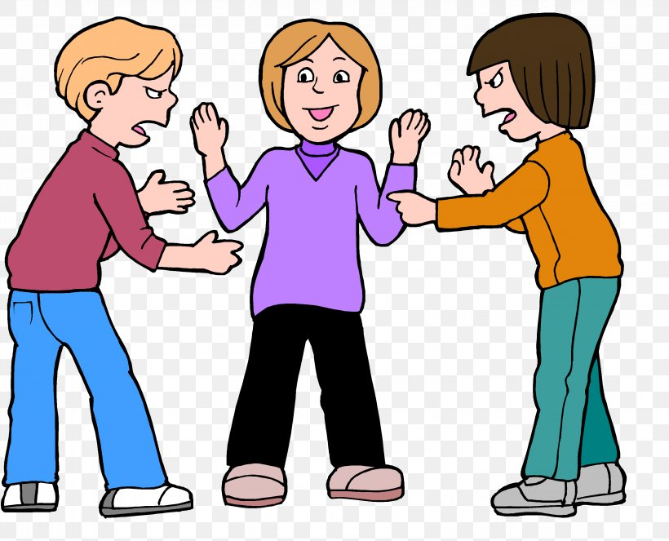

Slide 15
Principle – agree quickly – if you cant ask for help – division does nothing for the glory of God, shows a poor example to the world, is the responsibility of all, and does nothing for our peace of mind.

Slide 16
Matthew 6 v 25 - 33
25 “Therefore I tell you, do not be anxious about your life, what you will eat or what you will drink, nor about your body, what you will put on. Is not life more than food, and the body more than clothing? 26 Look at the birds of the air: they neither sow nor reap nor gather into barns, and yet your heavenly Father feeds them. Are you not of more value than they? 27 And which of you by being anxious can add a single hour to his span of life?[g]

Slide 17
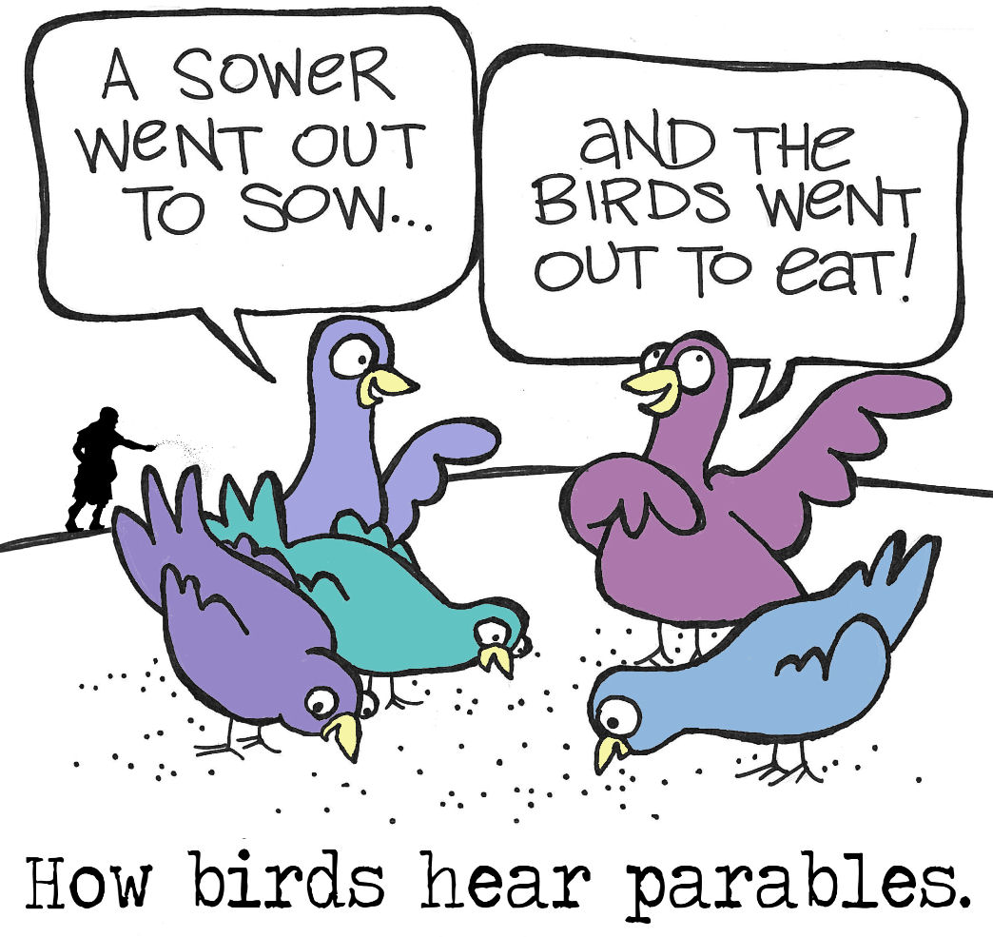

Slide 18


Slide 19
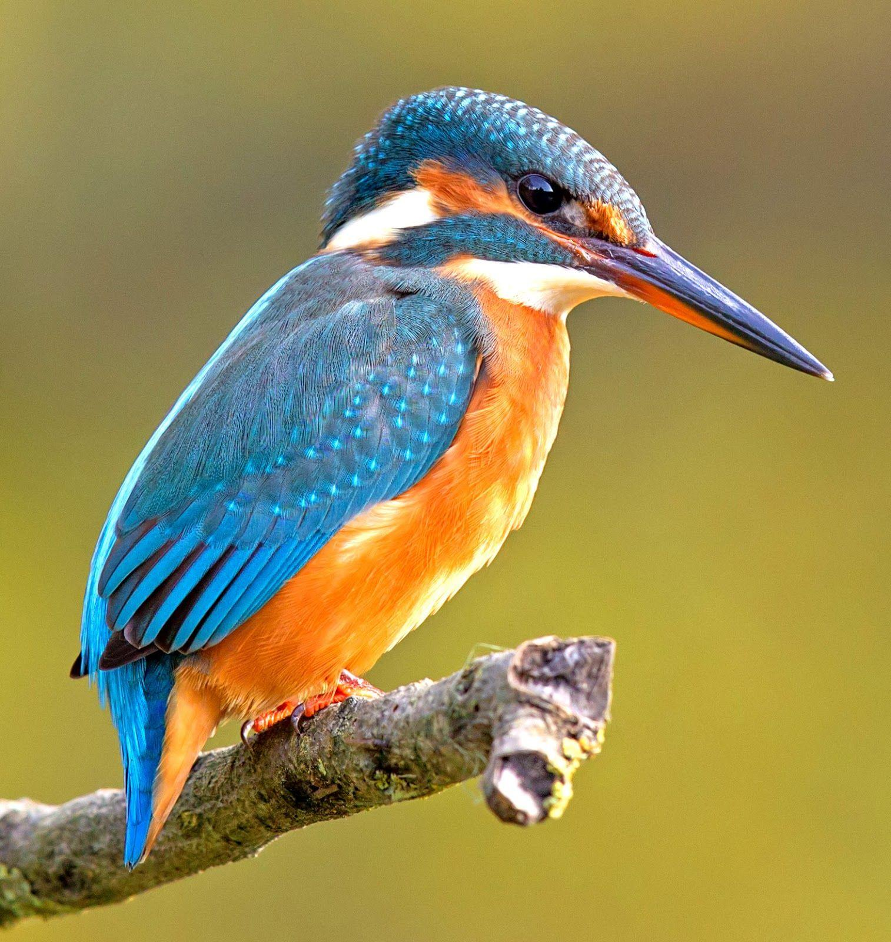

Slide 20
28 And why are you anxious about clothing? Consider the lilies of the field, how they grow: they neither toil nor spin, 29 yet I tell you, even Solomon in all his glory was not arrayed like one of these. 30 But if God so clothes the grass of the field, which today is alive and tomorrow is thrown into the oven, will he not much more clothe you, O you of little faith?

Slide 21
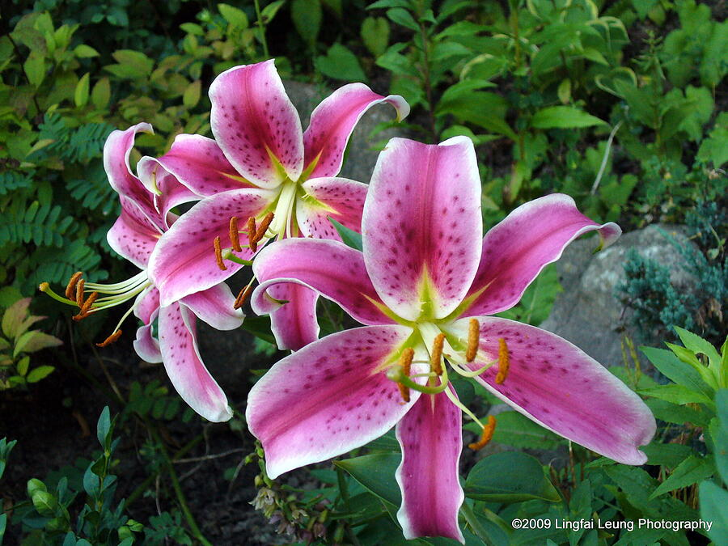

Slide 22
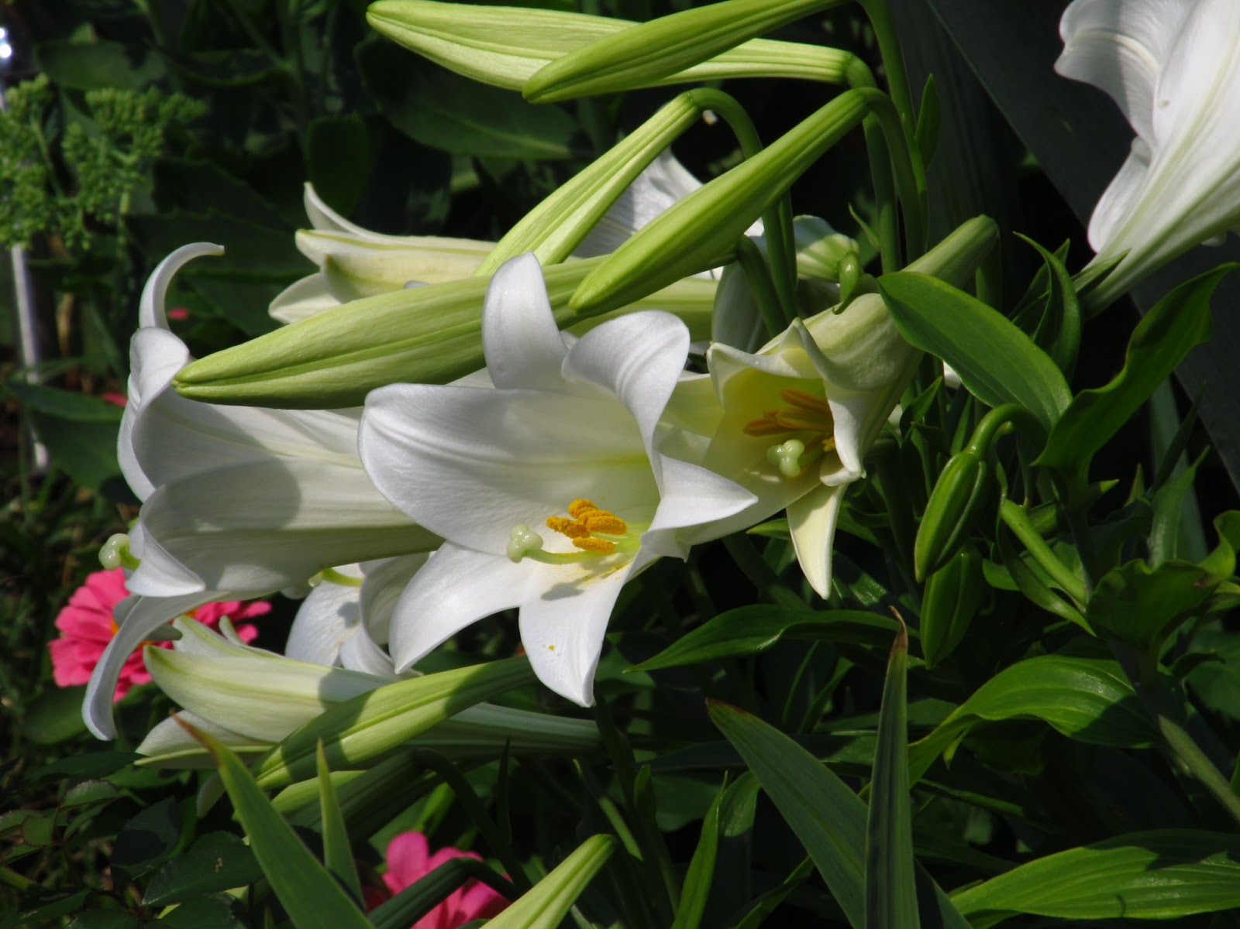

Slide 23


Slide 24
31 Therefore do not be anxious, saying, ‘What shall we eat?’ or ‘What shall we drink?’ or ‘What shall we wear?’ 32 For the Gentiles seek after all these things, and your heavenly Father knows that you need them all. 33 But seek first the kingdom of God and his righteousness, and all these things will be added to you.

Slide 25
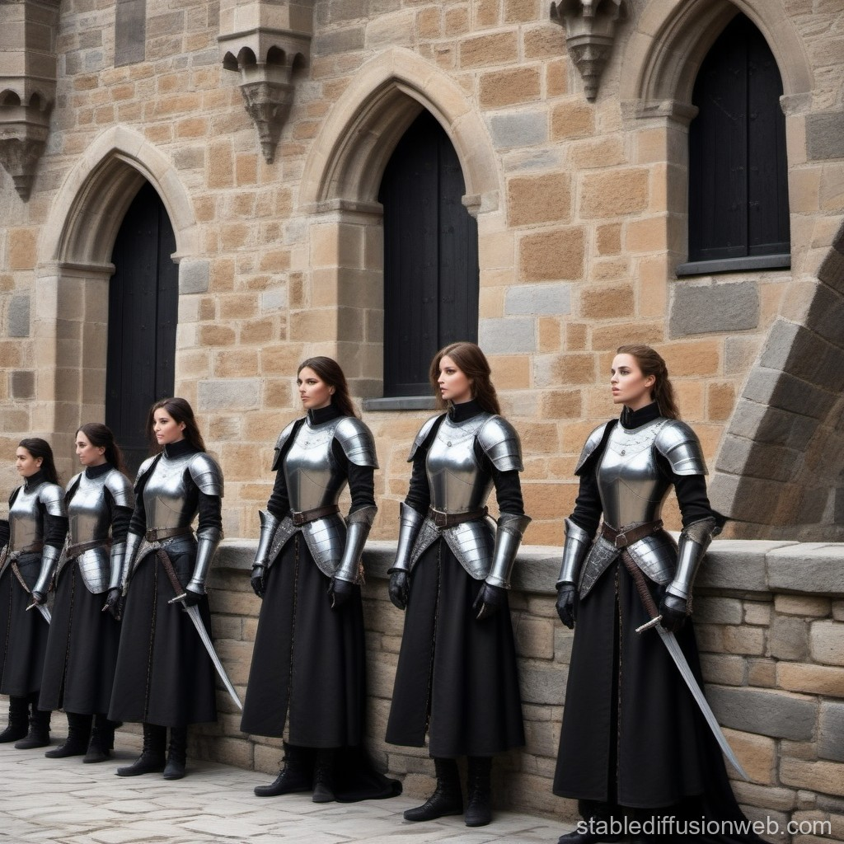

Slide 26
Contentment in Life

Slide 27
Hebrews 13 v 7 - 8
7 Remember your leaders, those who spoke to you the word of God. Consider the outcome of their way of life, and imitate their faith. 8 Jesus Christ is the same yesterday and today and for ever

Slide 28
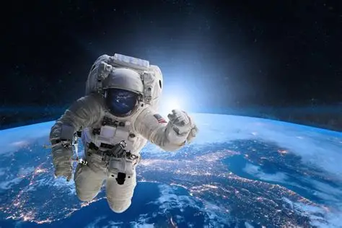

Slide 29
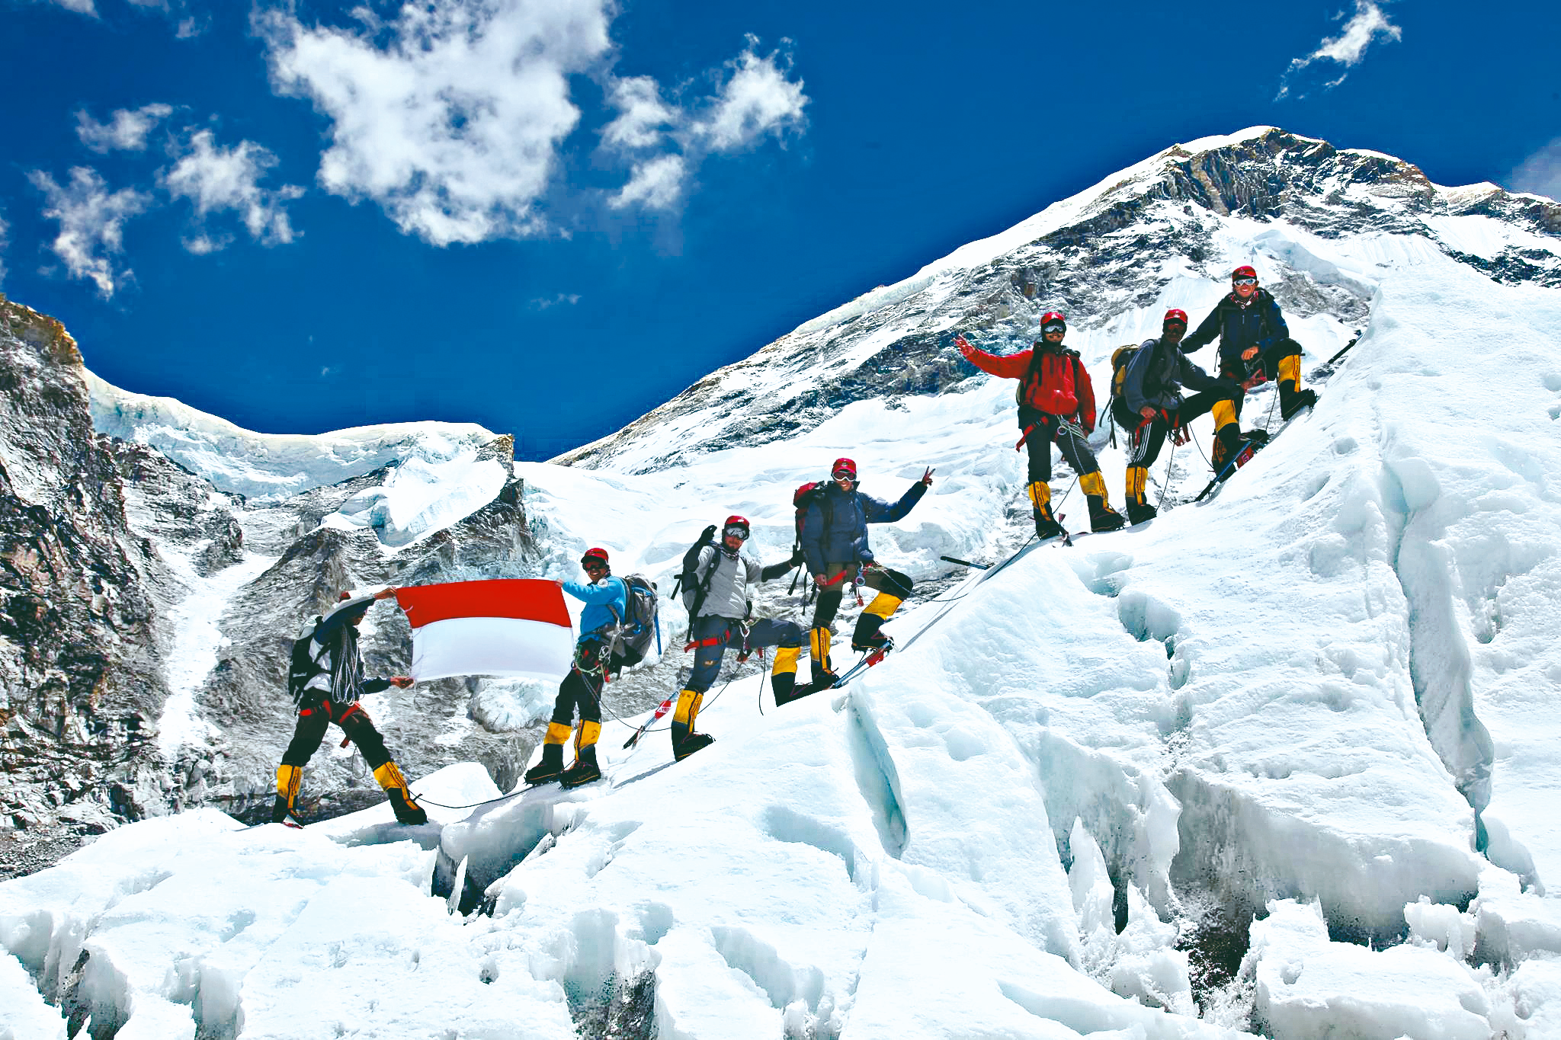

Slide 30
19 And my God will supply every need of yours according to his riches in glory in Christ Jesus. 20 To our God and Father be glory for ever and ever. Amen.

Slide 31


